Slide 1
Coursera Capstone
BY:
Nangineni Vijaya Lakshmi

Slide 2
Introduction
The objective of this Project is to identify better facilities around different neighbourhoods which will help people exploring these facilities smartly to take effective decision by selecting great neighbourhood out of many other neighbourhoods in Toronto.

Slide 3
Business Proposal
Here, I will determine the features of the neighbourhood and perform a comparative analysis between them. The features include median housing price and better school according to ratings, crime rates of that particular area, road connectivity, weather conditions, good management for emergency, water resources both fresh and wastewater and excrement conveyed in sewers and recreational facilities.

Slide 4
Target Audience
This project will facilitate people by generating awareness of the surrounding area and the neighbourhood before moving to the new place. While planning for suggesting a better neighbourhood in a new city for the people who are moving

Slide 5
Data Description
The data comes from dataset from the following link. It contains 227,428 check-ins in New York city. The data contains two files in tsv format. https://sites.google.com/site/yangdingqi/home/fo ursquare-dataset
Each file contains 8 columns.

Slide 6
Methodology
After extracting and reading the data, we will translate above data into a Pandas data frame for processing which would look like this. These are data elements that are needed when we call Foursquare web service call in order to get venues available in that neighbourhood

Slide 7
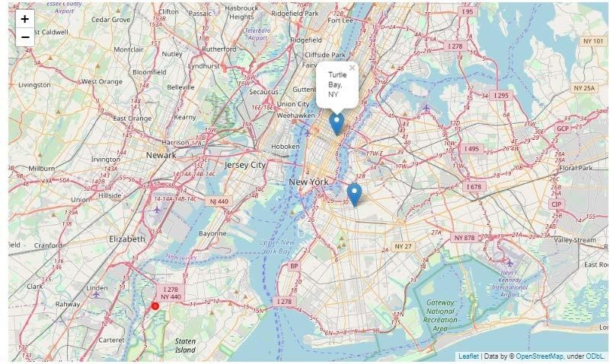

Results

Slide 8
Conclusion
In our sample of 2000 venues, we did find more than
10 coordinates that has no Bar (the most visited shop type according to sample) within four- kilometre sphere. Anyways, the results according to the data in hand can be checked from the map and analysis above can be of use for future entrepreneurs.

